Slide 1
Cross-enterprise Basic eReferral Workflow Definition
(XBeR-WD)
Brief Profile Proposal for 2011/12
presented to the
PCC Technical Committee
Luca Zalunardo, Arianna Cocchiglia
November, 15th 2011

Slide 2
The Problem
This profile proposal born as development of the ITI XDW profile to manage the Cross Enterprise Basic eReferral Workflow.
The management of the workflow related to the eReferral is involved in many clinical and organizational.
Without an instrument which manage its workflow, the eReferral is only an order without any information about the status of the order itself. The definition of a workflow with fix rules and task is needed in a scenario cross enterprise in which many actors are involved in the same process
We have estimated that only in the Veneto Region the introduction of the use of digital referral (eReferral) will entail a saving of about 56 million Euro thanks to:
a better quality control of the process
the reduction of the errors in the management of all clinical documents and related workflows
the increasing of the efficiency of the process itself.

Slide 3
XDW profile and Workflow Definition profile
Cross Enterprise Document Workflow is:
  a framework to manage workflows
  a platform upon which a wide range of specific workflows can be defined with minimal specification and implementation efforts
  workflow independent
  applicable on different document sharing infrastructures
Workflow Definition Profile is:
  the definition of a specific clinical process
  a set of rules and task definition which characterize the process
  the definition of the actors involved in the process and their roles

Slide 4

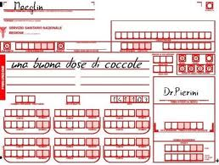




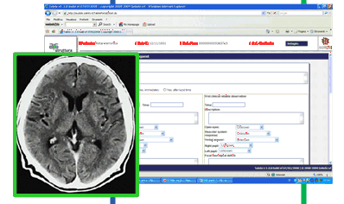
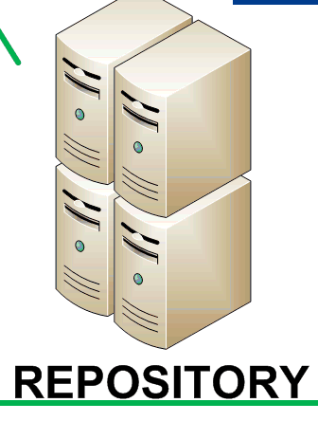
Use Case: an example of eReferral workflow
2-
Admission of
the patient
1-Visit and production of eReferral
3- Start of the Consultation
The workflow within the organization is encapsulated into a single XDW step
5 – Possible notification to the GP
4 – End of the consultation and creation of the clinical report

Slide 5
Use Case: an example of eReferral workflow
Workflow Document
task: REQUESTED
Status: COMPLETED
Author: Mr.Rossi
Time: date/time/utc
Inputs:
-> Lab Report
Outputs:
-> eReferralDoc1
Task A: Requested
  Status 1: Completed
1-Visit and production of eReferral
taskEventHistory
TaskEvent: 1
Status: COMPLETED
Inputs:
-> Lab Report
Outputs:
-> eReferralDoc1

Slide 6
Use Case: an example of eReferral workflow
Workflow Document
REQUESTED
task: REFERRED
Status: INPROGRESS
Author: Mr.Brum
Time: date/time/utc
Inputs:
-> eReferralDoc1
Outputs:
->
2-
Admission of
the patient
Task B: Referred
  Status 1: In Progress
taskEventHistory
TaskEvent: 1
Status: INPROGRESS
Inputs:
-> eReferralDoc1
Outputs:
->
The workflow within the organization is encapsulated into a single XDW step

Slide 7
Use Case: an example of eReferral workflow
Workflow Document
REQUESTED
task: REFERRED
Status: COMPLETED
Author: Mr.Brum
Time: date/time/utc
Inputs:
-> eReferralDoc1
Outputs:
-> ClinicalRepDoc2
Task B: Referred
  Status 2: Completed
3- Start of the Consultation
taskEventHistory
TaskEvent: 1
TaskEvent: 2
Status: COMPLETED
Inputs:
-> eReferralDoc1
Outputs:
-> ClinicalRepDoc3
The workflow within the organization is encapsulated into a single XDW step
5 – Possible notification to the GP
4 – End of the consultation and creation of the clinical report

Slide 8
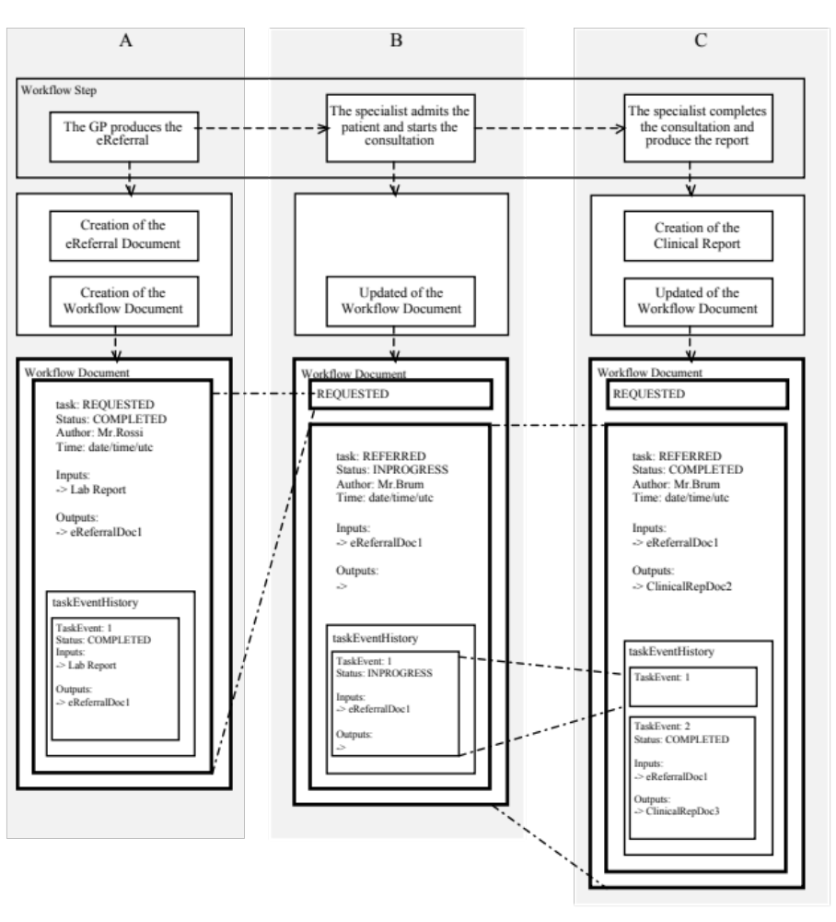
Use Case: an example of eReferral workflow(2)
Workflow
Description
XDW
Evolution
of shared
Workflow
Document

Slide 9
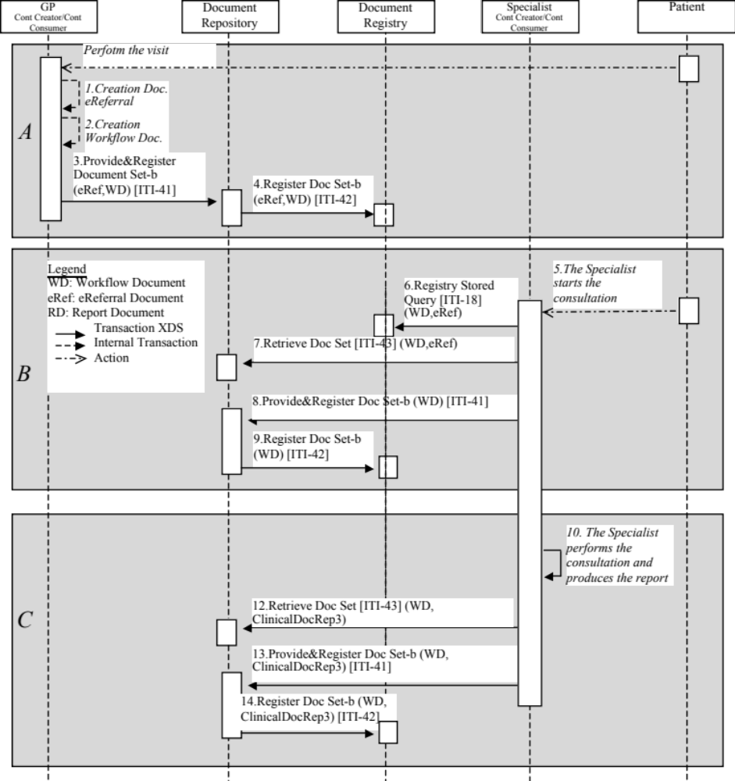
Process Flow

Slide 10
Proposed Standards & Systems
Afferent IHE Domains
  IT Infrastructure, Patient Care Coordinator
Afferent IHE Profiles:
  XDW, XDS.b, XDM, XDR, DSUB, NAV, XCA, BPPC, ATNA, XUA
Other standards items:
  OASIS HumanTask
Stability and robustness:
  No new transaction are introduced
  No XDS Metadata extension expected, but specific rules about Metadata content for the workflow Document
Notes:
Radiology, Cardiology, Ophthalmology, Radiation Oncology, Reporting Workflow, Mammo CAD, Labs, and Pharma all fit this structure

Slide 11
Technical Approach
XDW is a framework to manage workflows
XDW needs to be specified throw the use of Workflow Definition profiles on the different workflow by the specific domains
Why PCC should profile XBeR-WD?
  XBeR involves a clinical process based on the patient
  XBeR is a first simple example of clinical process management
  PCC is focus on the Patient Care Coordination and so it has the competence to analyze and define the process in which are involved many actors (as a process related to eReferral)
  PCC thanks to his competence to Patient Care Coordination is the best candidate to write the first Workflow Definition Profile

Slide 12
Technical Approach
The work requested to PCC is on the definition of the process:
  Definition of the tasks
  Sequence the tasks and their relation
  Actors involved in the process
  Rules of the process
  …..
Structure of a Workflow Definition profile need to be defined
No work to define the structure of the Workflow Document is requested
No new transactions or actors are requested

Slide 13
Workflow Definition
2-
Admission of
the patient
1-Visit and production of eReferral
3- Start of the Consultation
The workflow within the organization is encapsulated into a single XDW step
5 – Possible notification to the GP
4 – End of the consultation and creation of the clinical report

Slide 14




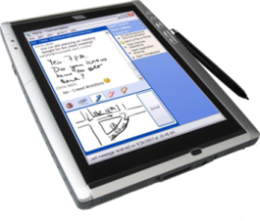

XDS Flow and Interactions
Content Creator
Content Consumer
XDS Infrastructure
2. Consumers search about patient’s workflows
1. Sources post workflow document and referenced document to the XDS Infrastructure
3. Consumers retrieve selected documents from the XDS Infrastructure
Content Updater
5. Consumers search about patient’s workflows
Content Consumer
4. Sources update the workflow document and post possible new referenced documents
6. Consumers retrieve selected documents from the XDS Infrastructure
Notes:
Slide with animation: see in presentation mode.

Slide 15
Example of XDW taskData element
<ns3:taskData>
<ns2:taskDetails>
<ns2:id>1</ns2:id>
<ns2:taskType>Requested</ns2:taskType>
<ns2:name>ReferralRequested</ns2:name>
<ns2:status>COMPLETED</ns2:status>
<ns2:createdTime>2006-05-04T18:13:51.0Z</ns2:createdTime>
<ns2:lastModifiedTime>2006-05-04T18:13:51.0Z</ns2:lastModifiedTime>
<ns2:renderingMethodExists>false</ns2:renderingMethodExists>
</ns2:taskDetails>
<ns2:description></ns2:description>
<ns2:input>
<ns2:part name="xdw">
<reference uid="urn:oid:1.2.3.4.4.3.2.2.3"/> <!-- LabReport -->
</ns2:part>
</ns2:input>
<ns2:output>
<ns2:part name="xdw">
<reference uid="urn:oid:1.2.3.4.4.4"/> <!-- eReferralDoc1 -->
</ns2:part>
</ns2:output>
</ns3:taskData>

Slide 16
XDW Security/Privacy and XBeR-WD risks
XDW relies on the security controls in the underlining transport (e.g. XDS)
In order to adhere to the principle of least privilege organizations want to prevent clinical documents from being replaced by other organizations, while allowing XDW Workflow Documents to be replaced (exception based on classCode)
When a Workflow Description Profile is created a risk assessment following the Security Cookbook may result in additional security considerations beyond those for the usual clinical report
This profile proposal does not have particular risk. The difficulties that can be find during the work of profiling could be on the standardization of the process itself which could have some variances in the different country. However, it is sufficient simple and similar in the different country to find a common workflow.

Slide 17
Discussion
The value statement of this proposal is:
the standardization of the workflow for eReferrals and of its management;
the use of an instrument, the ITI XDW profile, which provides a shared solution with different process which guarantees the interoperability between the different workflows and their management.
The specification of Workflow Definitions is distinct from the XDW Profile, out of the scope of the ITI Domain and is currently best handled with a natural language expression, it is specific duty of each domain to define the workflow definition profile to manage the different specific workflow.
This is a simple process which can provide the basis to the definitions of other more complex clinical workflows.

Slide 18
Effort Estimates
The work effort (in term of documentation) for profiling the XBeR-WD is low/medium because there aren’t new transactions and the new actor and the structure of the document is defined by ITI.
The work will be focused only on the definition of the process and its rules.
Profile editors:
  Luca Zalunardo, Arsenàl.IT, lzalunardo@consorzioarsenal.it
  Arianna Cocchiglia, Arsenàl.IT, acocchiglia@consorzioarsenal.it
  Organization: Arsenàl.IT, www.consorzioarsenal.it

Slide 19
Publication of both Referral Request and Workflow Document by GP’s EHR
Application of XDW
in the Veneto Region
Workflow Document
HIS - Hospital Information System
task: REQUESTED
Status: COMPLETED
Author: Mr.Rossi
Time: date/time/utc
Inputs:
-> Lab Report
Outputs:
-> eReferralDoc1
GP’s EHR
(XDS Document Source)
Document Registry
XDS Provide and
Register Document Set – b
XDS Register
Document Set – b
taskEventHistory
Document Repository
TaskEvent: 1
Status: COMPLETED
Inputs:
-> Lab Report
Outputs:
-> eReferralDoc1
HIS Booking System
(Document Consumer)
LIS – Laboratory Information System

Slide 20
Retrieve of Workflow Document by HIS, check of the status of the process and retrieve of the eReferral
Application of XDW
in the Veneto Region
HIS - Hospital Information System
GP’s EHR
(XDS Document Source)
Document Registry
XDS Registry
Stored Query
Document Repository
XDS Retrieve
Document Set.b
HIS Booking System
(Document Consumer)
LIS – Laboratory Information System

Slide 21
Update and publication of the Workflow Document
Application of XDW
in the Veneto Region
Workflow Document
HIS - Hospital Information System
REQUESTED
GP’s EHR
(XDS Document Source)
Document Registry
task: REFERRED
Status: INPROGRESS
Author: Mr.Brum
Time: date/time/utc
Inputs:
-> eReferralDoc1
Outputs:
->
XDS Register
Document Set-b
Document Repository
XDS Provide and
Register Document Set-b
taskEventHistory
TaskEvent: 1
Status: INPROGRESS
Inputs:
-> eReferralDoc1
Outputs:
->
HIS Booking System
(Document Consumer)
LIS – Laboratory Information System

Slide 22
Update and publication of the Workflow Document, publication of the Laboratory report
Application of XDW
in the Veneto Region
Workflow Document
HIS - Hospital Information System
REQUESTED
GP’s EHR
(XDS Document Source)
Document Registry
task: REFERRED
Status: COMPLETED
Author: Mr.Brum
Time: date/time/utc
Inputs:
-> eReferralDoc1
Outputs:
-> ClinicalRepDoc2
XDS Register
Document Set-b
Document Repository
XDS Provide and
Register Document Set-b
taskEventHistory
TaskEvent: 1
TaskEvent: 2
Status: COMPLETED
Inputs:
-> eReferralDoc1
Outputs:
-> ClinicalRepDoc3
HIS Booking System
(Document Consumer)
LIS – Laboratory Information System

Slide 23
Retrieve of Workflow Document by the GP, check of the status of the process and retrieve of reports if available
Application of XDW
in the Veneto Region
HIS - Hospital Information System
GP’s EHR
(XDS Document Source)
Document Registry
XDS Registry
Stored Query
Document Repository
XDS Retrieve
Document Set.b
HIS Booking System
(Document Consumer)
LIS – Laboratory Information System

